Slide 1
Final Project Review
EMA/IS1 HT 2021
Group 29
Dipayan Sarker (disa2777@student.su.se), Johan Olausson(jool5820@student.su.se), Nishant Chahar, Nicole Issa (niis8974@student.su.se), Peilin Li (peli9693@student.su.se)

Slide 2
Introduction - SU Interactive
MMORPGs
Played throughout the entire world.
Combines the aspects of a role-playing video game and a massively multiplayer online game.
Common features: persistent game environment, level and character progression, social interaction within the game, in-game culture, system architecture, membership in a group, and character customization.
SU Interactive
SU Interactive is a start-up company producing and selling an MMORPG.
Game will be sold directly to customers, trough computer game retailers and through Google Stadia.
Agreement with ISP’s, third-party suppliers, IT-service provider and a data mining firm.
Sponsoring Game Forum.

Slide 3
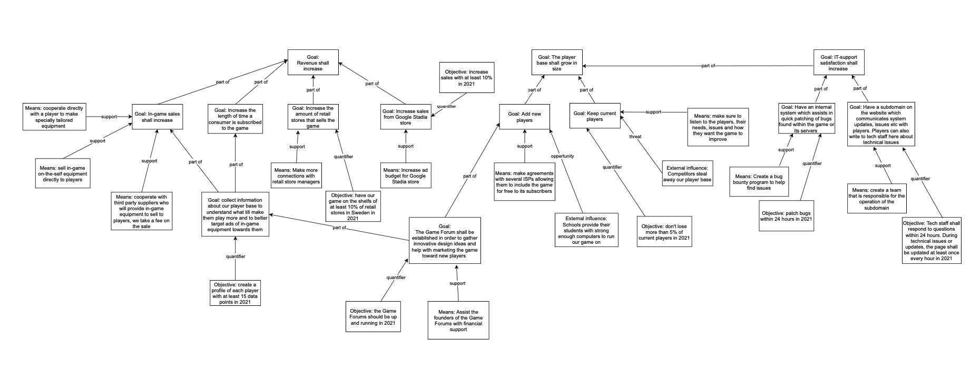
SU Interactive Goal Models

Slide 4
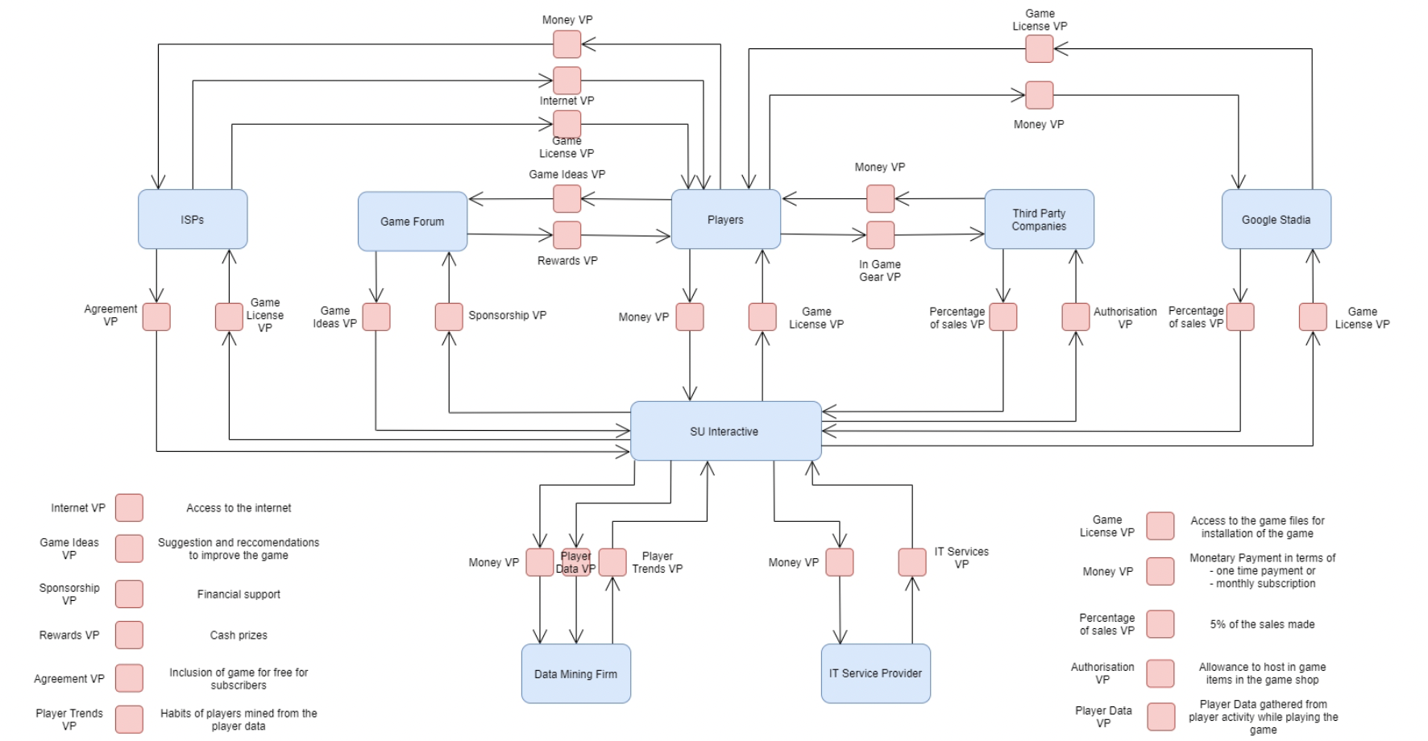
SU Interactive - VDML Diagram

Slide 5
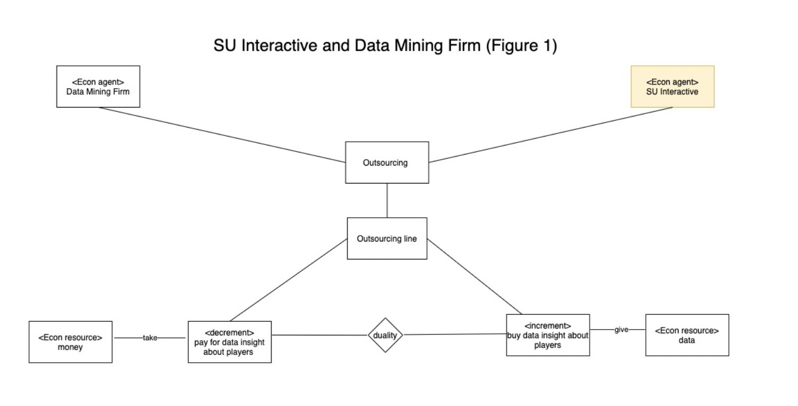
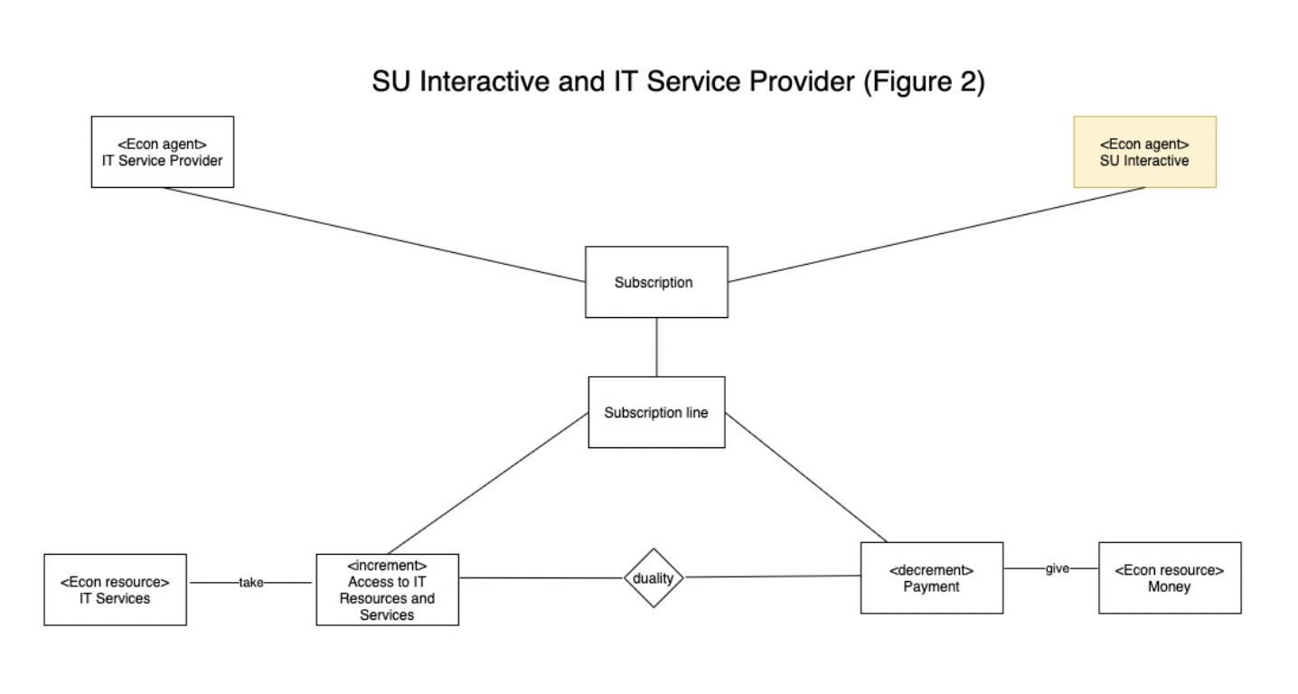
SU Interactive REA Models

Slide 6
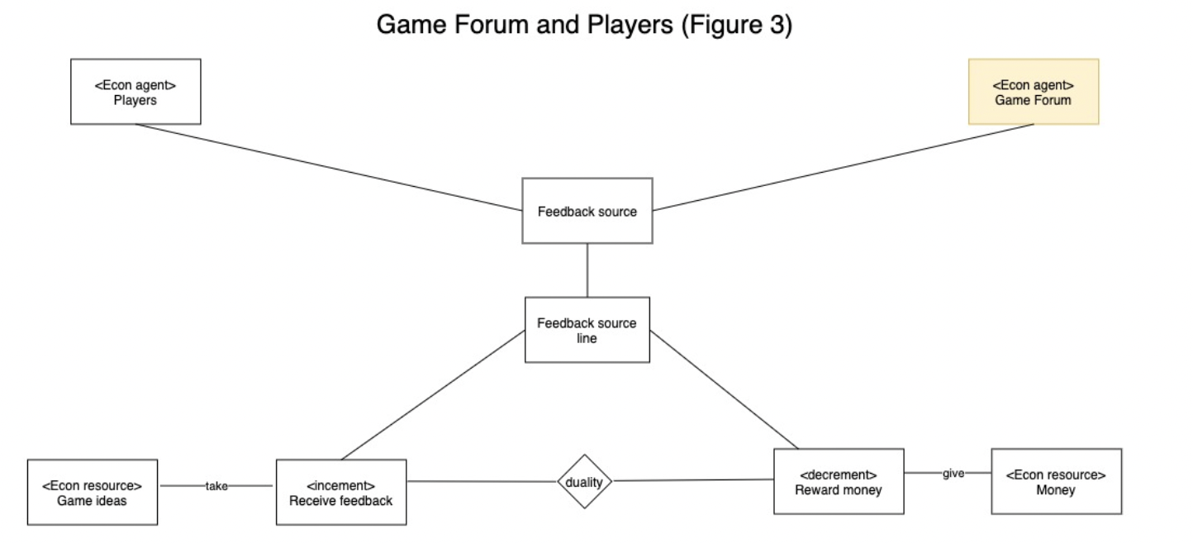
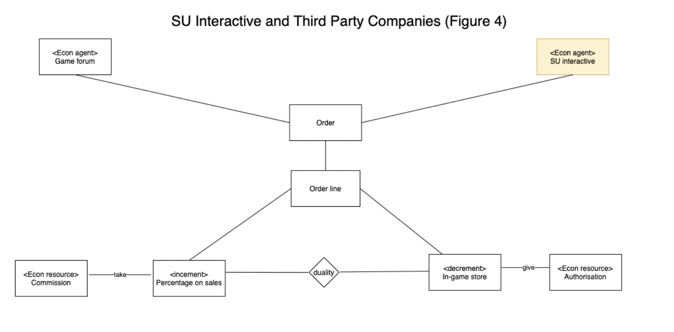
SU Interactive REA Models

Slide 7
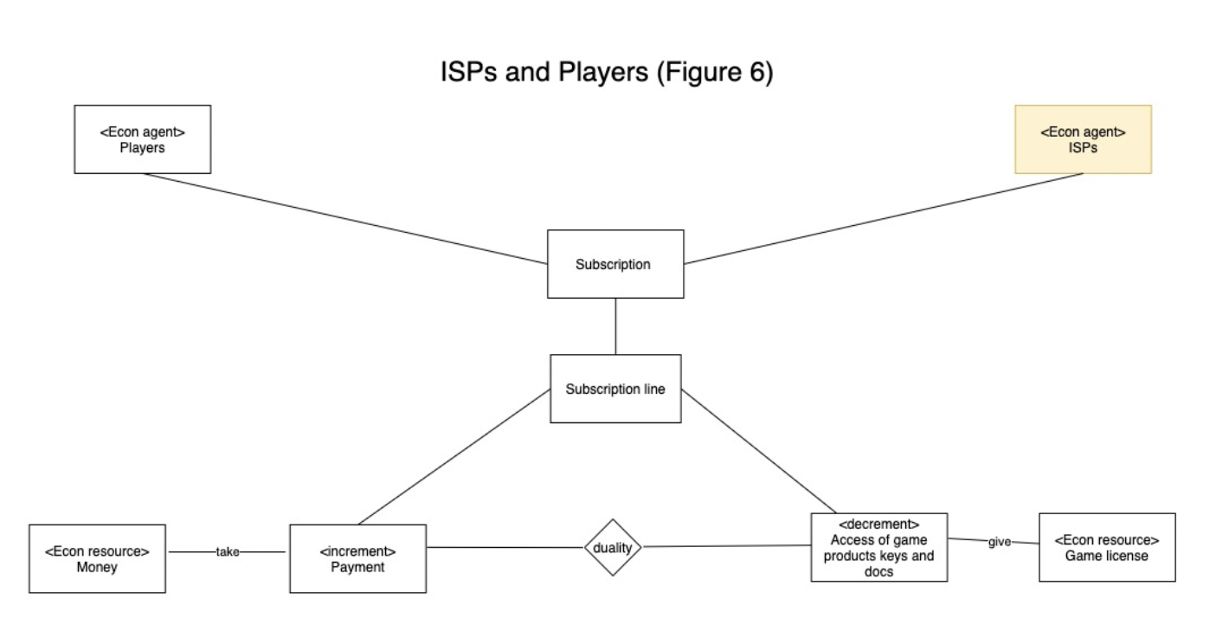
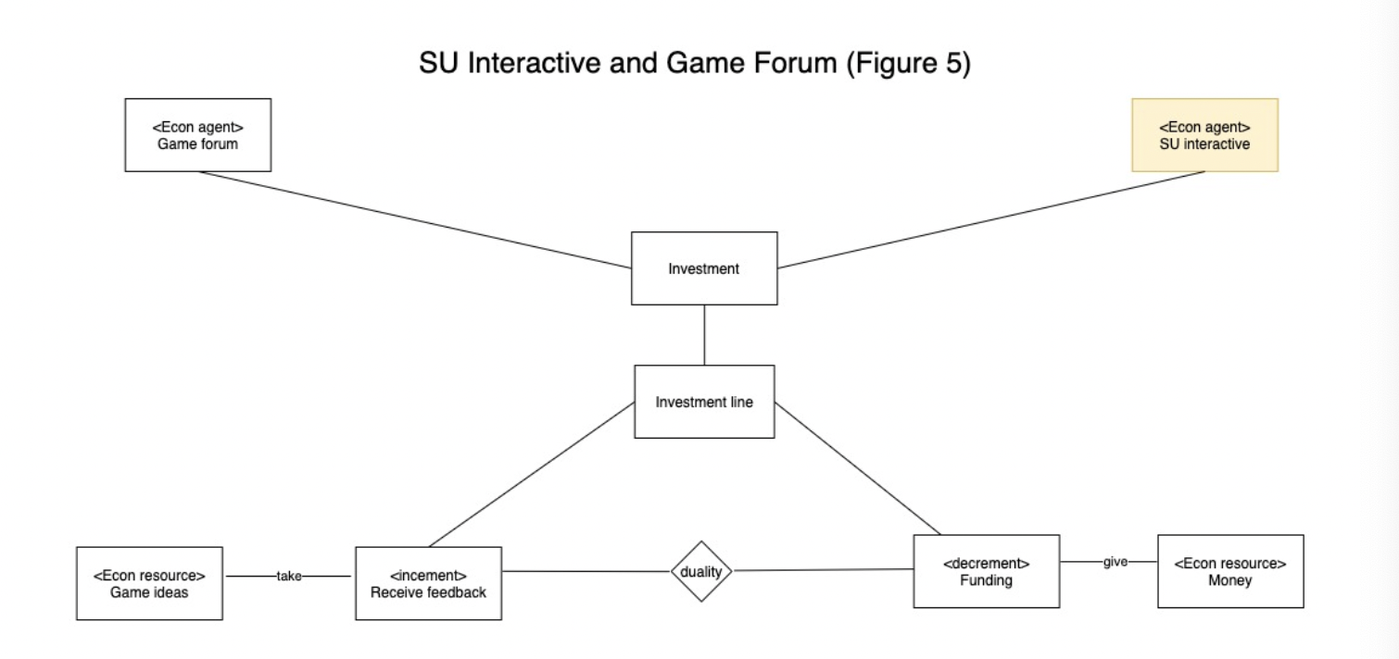
SU Interactive REA Models

Slide 8
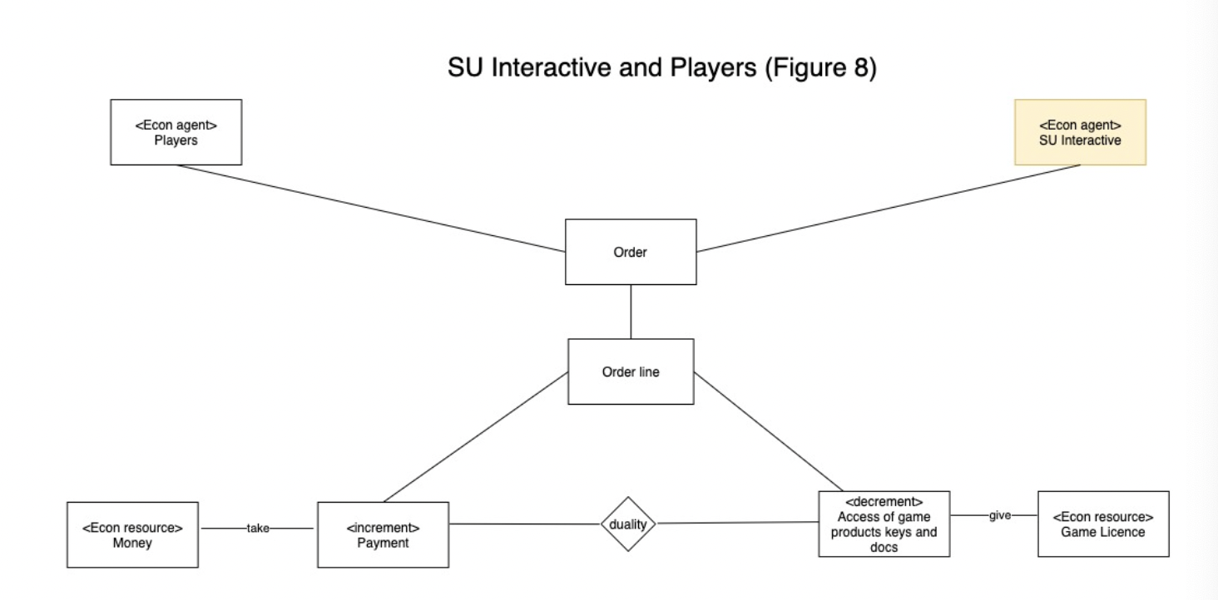
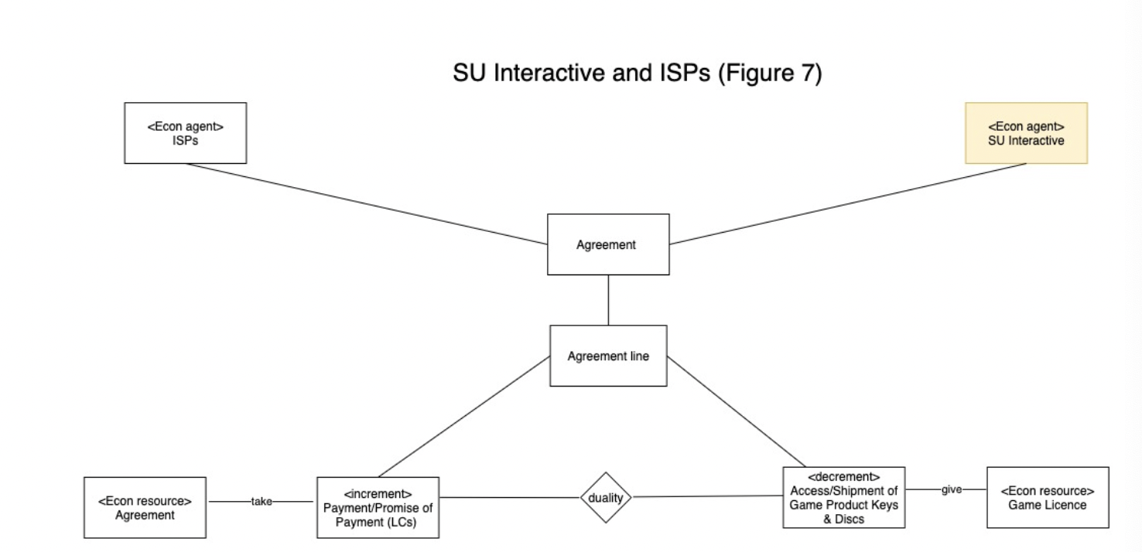
SU Interactive REA Models

Slide 9
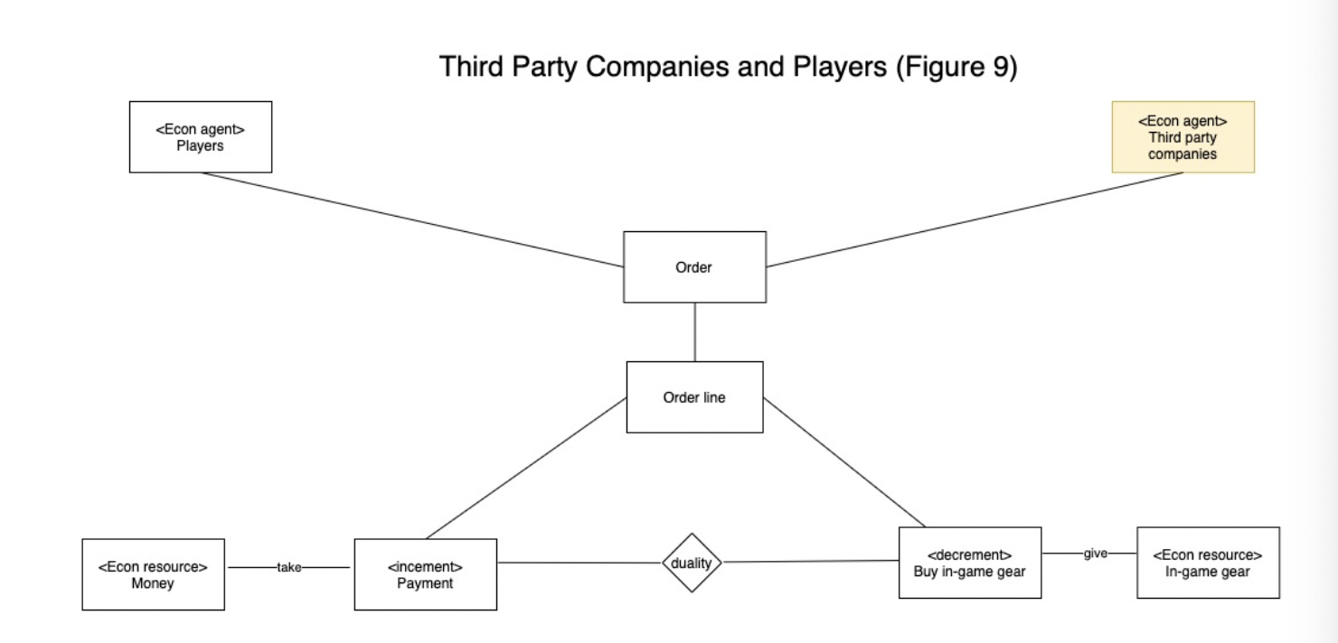
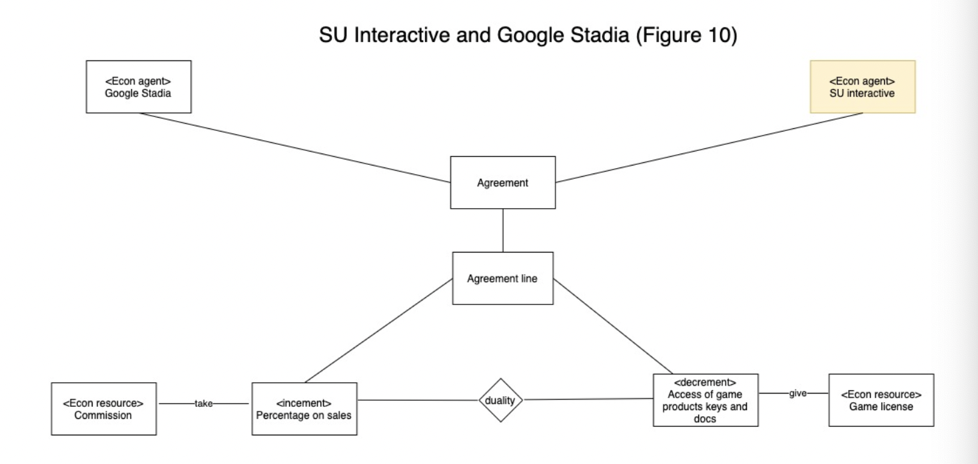
SU Interactive REA Models

Slide 10
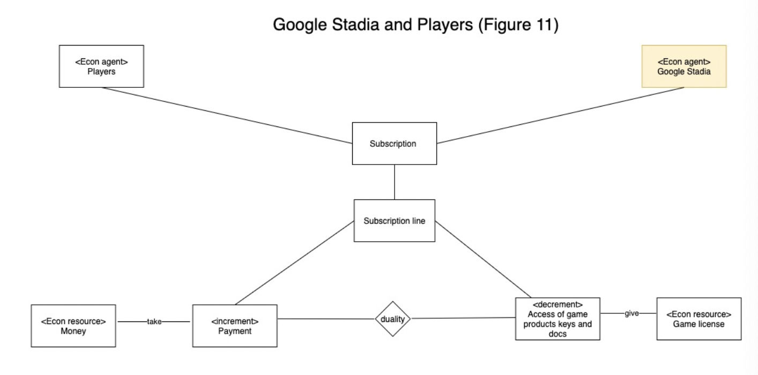
SU Interactive REA Models

Slide 11
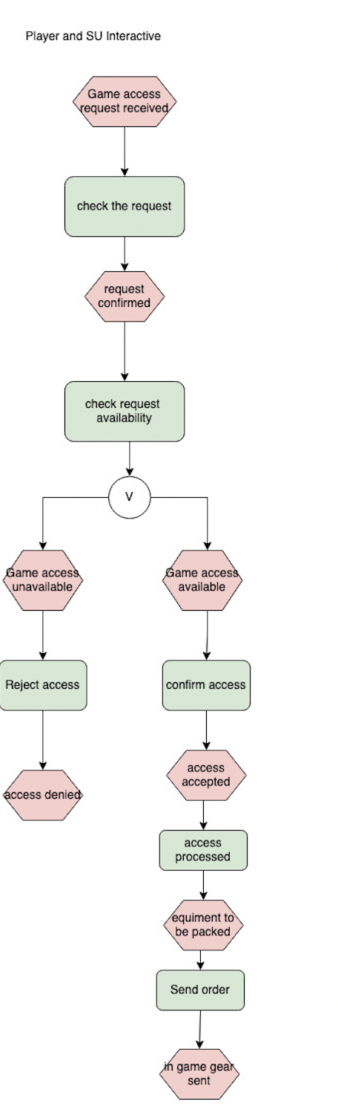
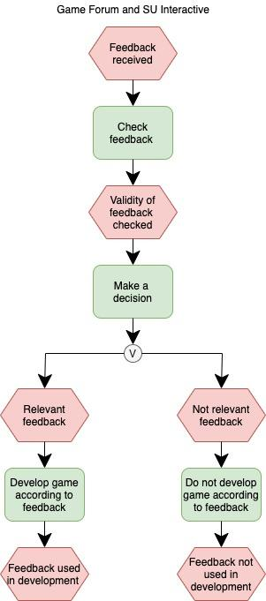
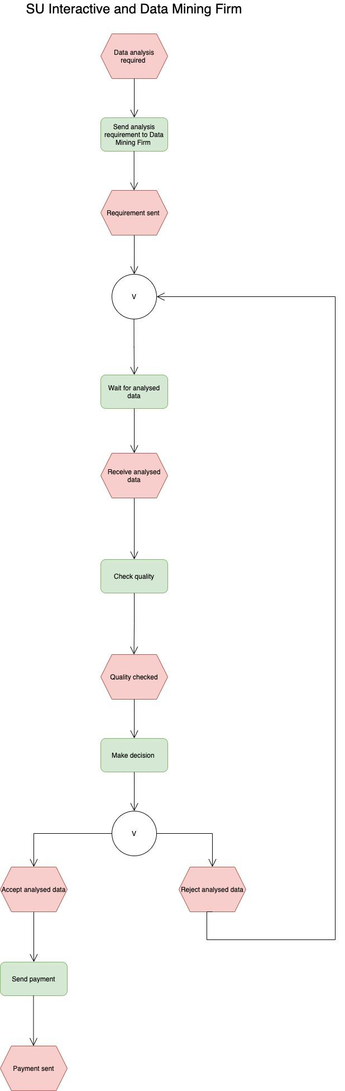
SU Interactive EPC Diagrams

Slide 12
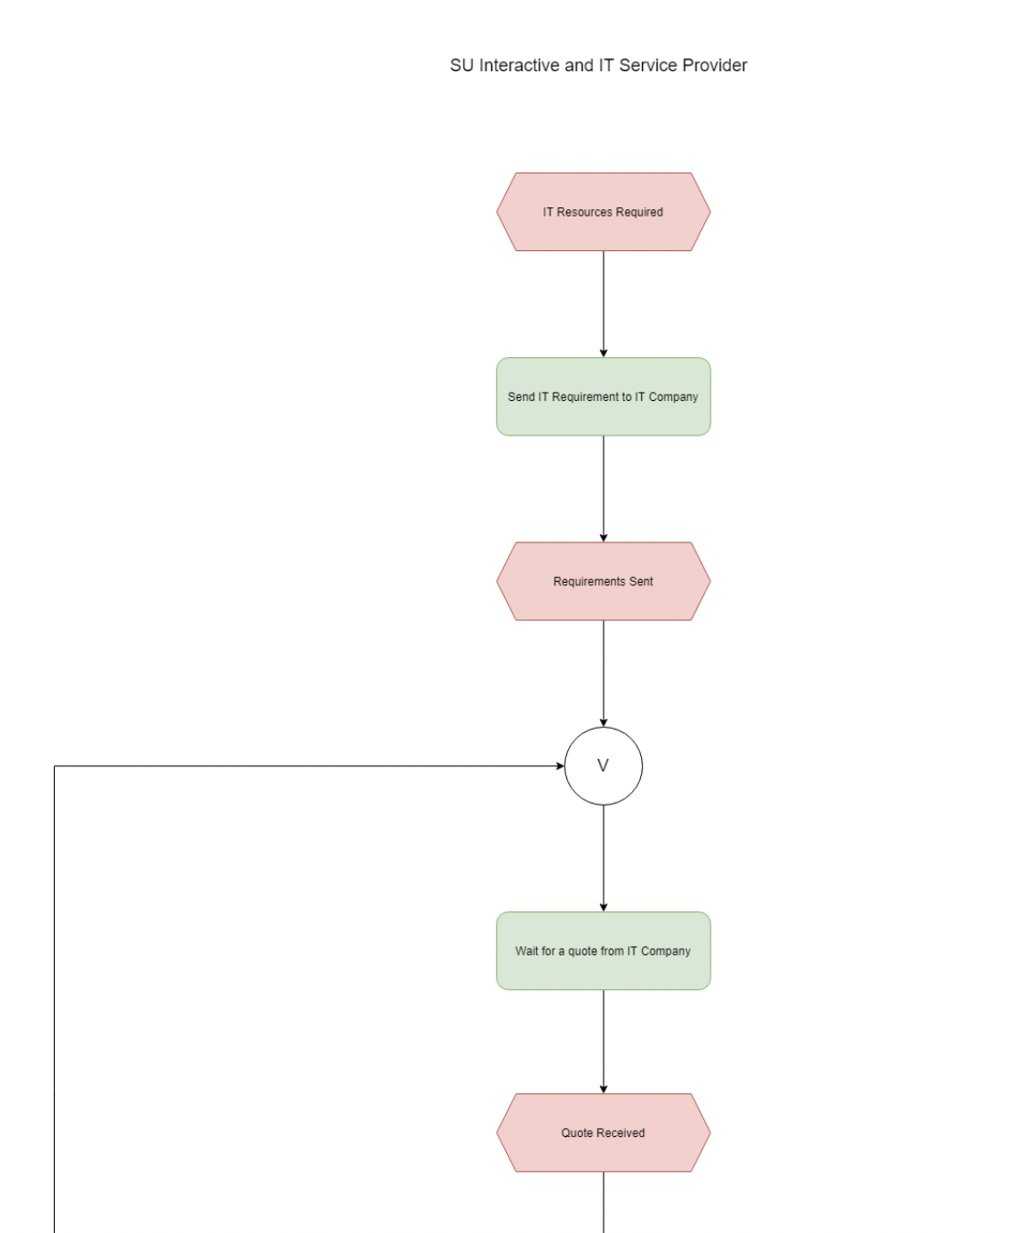
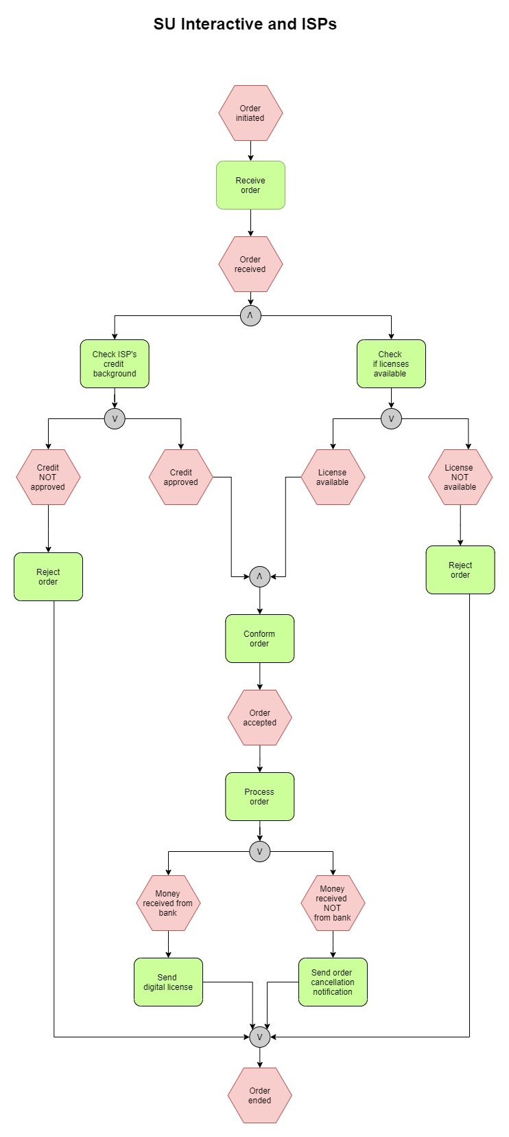
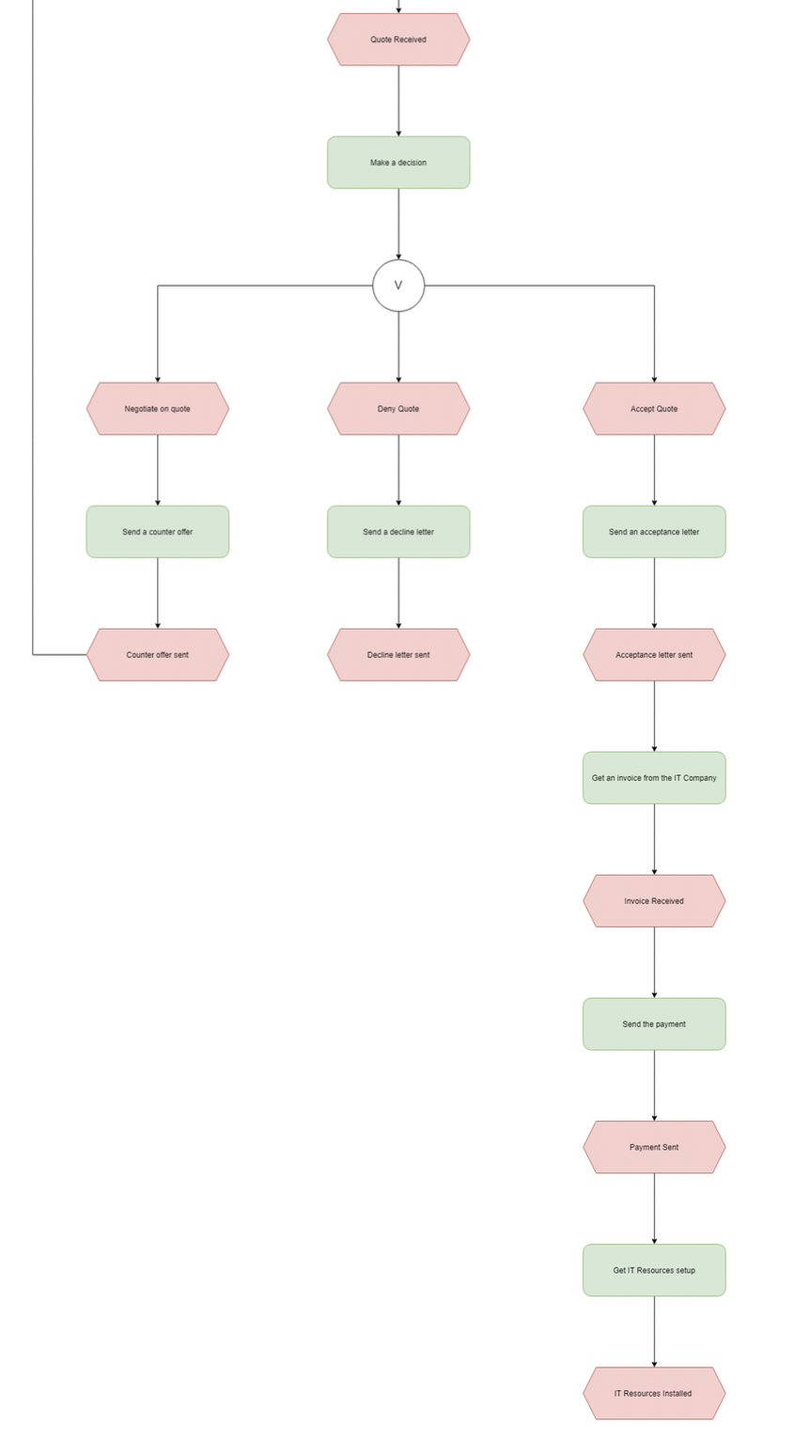
SU Interactive EPC Diagrams

Slide 13
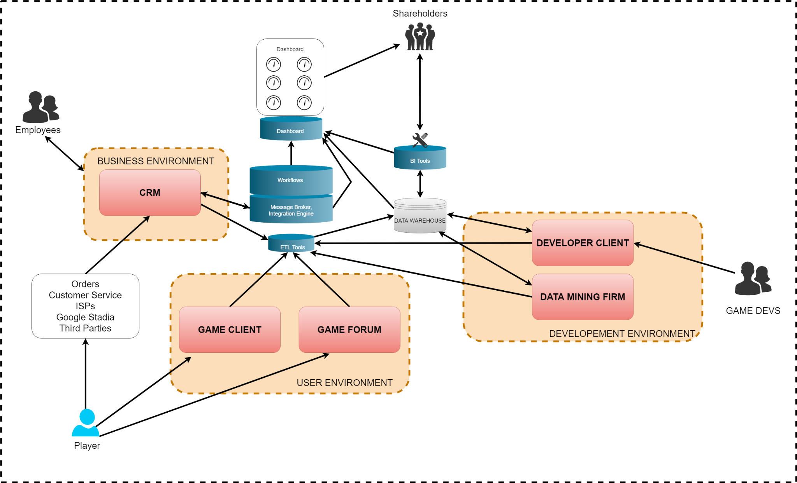
IT Architecture

